Slide 1




MS
PowerPoint
Class V
lab 19

Slide 2

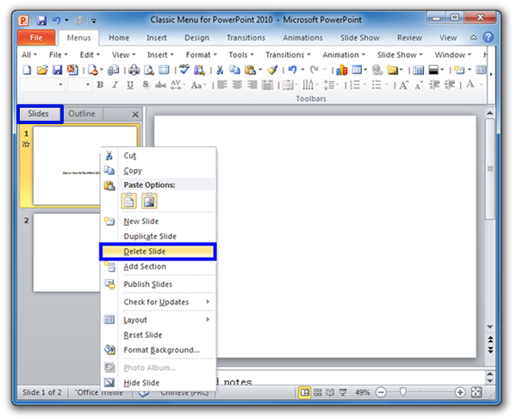
Deleting Slides
1.Press the delete key on the keyboard
2.Press the backspace key on the keyboard
3.Right click on the slide and select Delete Slide

Slide 3
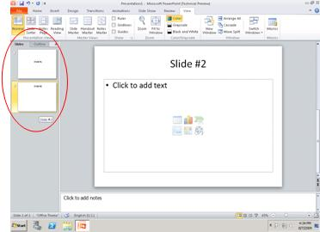
Moving Slides
To move a slide in your presentation, all you have to do is drag and drop it where you need it

Slide 4
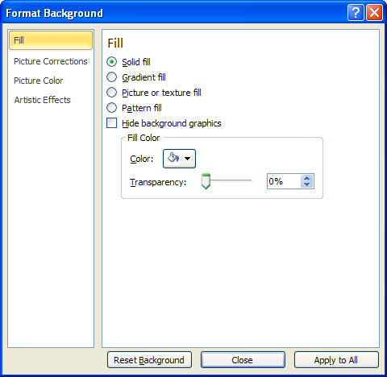
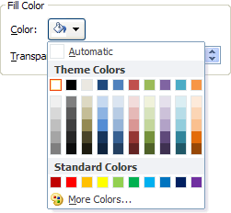
Creating Background
For the background to your PowerPoint presentation, you can specify the following:
A solid fill
A gradient fill
A picture or texture fill
A Pattern fill

Slide 5
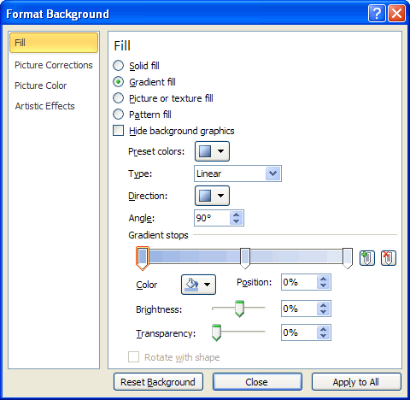
Gradient Fill
A gradient is the smooth transition of one colour into another

Slide 6


